Slide 1
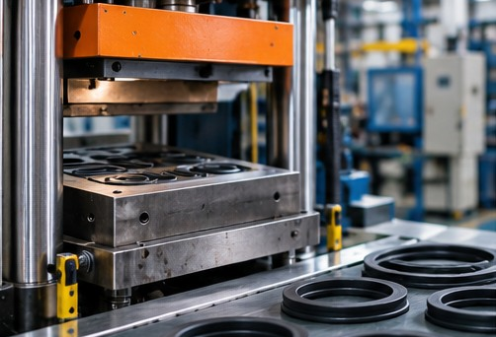

The Purple Team
Build an independent sales business in manufacturing - a one-hour introduction
David Chao, President & CEO, COi Rubber Products
The Purple Team is a proposed pilot program. Participation and earnings are not guaranteed.
Notes:
Welcome (3 min). Introduce yourself and COi in one breath: a US-owned custom rubber manufacturer. Frame the hour: what the Purple Team is, what you will learn from the six free guides, and how to apply. Set expectations early: this is a developing pilot program - applying is free, review is real, and earnings are not guaranteed.

Slide 2
PART 1 - WHO WE ARE
COi Rubber at a glance
US-owned custom rubber and plastics manufacturer
Serves automotive, appliance, HVAC and industrial customers nationwide
Our manufacturing facility is IATF 16949 certified
Sales offices in Diamond Bar and Pomona, California
COi handles technical quoting, manufacturing and fulfillment
What reps tap into
Real products buyers already source
A technical team behind every quote
Production and shipping run by COi
The Purple Team - Powered by COi Rubber
2 / 16
Notes:
COi credibility (4 min). The point for a prospect: you are not selling a concept. COi makes real custom components, stands behind quality with an IATF 16949 certified facility, and runs quoting, production and fulfillment. Transition: so where do you fit in? That is the Purple Team.

Slide 3
PART 2 - THE PROGRAM
What the Purple Team is
A network of independent sales representatives, powered by COi Rubber
Help manufacturers source custom rubber and plastic components
Non-exclusive: keep your current product lines
A developing pilot program - training and support tools are being built now
Straight talk
Participation and earnings are not guaranteed.
Applying is free. Applicants are reviewed by our team.
The Purple Team - Powered by COi Rubber
3 / 16
Notes:
Define the offer honestly (4 min). The Purple Team lets an independent rep build a manufacturing sales business without buying machines or hiring engineers. Stress non-exclusivity and the pilot status, then say the quiet part out loud: participation and earnings are not guaranteed. Transition: why is this worth your time? Look at the market.

Slide 4
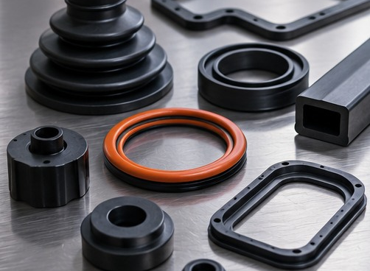
PART 2 - THE MARKET
Rubber and plastic parts are everywhere
$287.9
billion in 2024 US shipments, plastics and rubber products manufacturing (NAICS 326)
Source: US Census Bureau, Annual Integrated Economic Survey via FRED
Every one of these industries buys custom components:
Motor vehicles - HVAC - industrial machinery - medical equipment - electronics - farm and construction equipment - aerospace - rail - marine
The Purple Team - Powered by COi Rubber
4 / 16
Notes:
Size the opportunity (4 min). Nearly $288 billion in US shipments in 2024, and that is one NAICS code. Every industry on this list needs gaskets, seals, molded and extruded parts - and every buyer needs a second source. The rep's opening question is simple: who is your backup supplier? Transition: here is how the work splits between you and COi.

Slide 5
PART 2 - THE DIVISION OF LABOR
COi runs the factory. You run the relationships.
COi handles
Technical evaluation of requirements
Quoting and engineering review
Manufacturing and quality
Fulfillment and delivery
You handle
Finding the right accounts
Respectful first conversations
Understanding the requirement
Handing off a clean RFQ
Follow-up that earns the next order
The Purple Team - Powered by COi Rubber
5 / 16
Notes:
Make the job concrete (4 min). New reps often fear the technical side. They do not need to quote rubber - COi's engineers do that. What the rep must do well is listen, distinguish facts from assumptions, and bring the right people into the conversation. That is trainable, and that is what the six guides teach. Transition: here is the path from today to your first review.

Slide 6
PART 2 - THE PATH
Your path through the Purple Team
1
Read
Six free guides by David Chao, plus a trainer guide - read first, then decide if this fits you
2
See the opportunity
What COi makes, how the work runs, who can join
3
Learn
Academy lessons and a career path, being built for the pilot
4
Apply
Free application. Our team reviews every applicant
Each step says what is available today and what is still being built.
The Purple Team - Powered by COi Rubber
6 / 16
Notes:
Show the path (3 min). No one is asked to commit before they learn. Reading is free, applying is free, and the review is real - not everyone is accepted. The Academy and career path are in development, and we say so plainly rather than overselling. Transition: the heart of the program is the reading, so let me walk you through each guide.

Slide 7
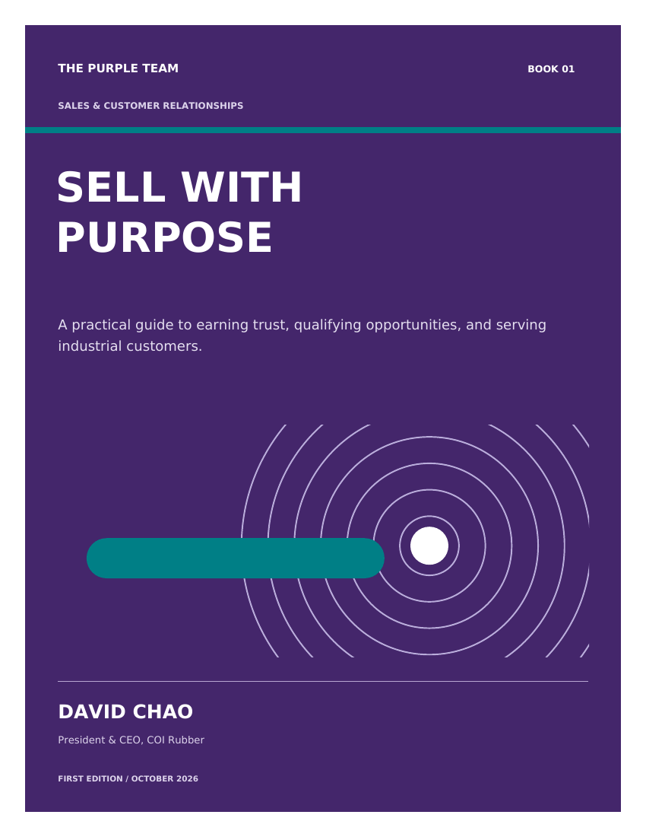
Book 01
Sell With Purpose
Sales and customer relationships
Become useful before you become persuasive
Choose accounts you can actually help
Turn a need into a useful RFQ
Follow up with judgment - earn the next order
The Purple Team - Powered by COi Rubber
7 / 16
Notes:
Book walk-through 01 (4 min each, 24 min total). Start with the customer's work. Listen carefully, qualify honestly, and let every conversation make you more accurate. Point the room to the free download: coirubber.com/reps/purple-team-library/. Each book ends with worksheets - read one chapter, practice one behavior, record what happened.

Slide 8
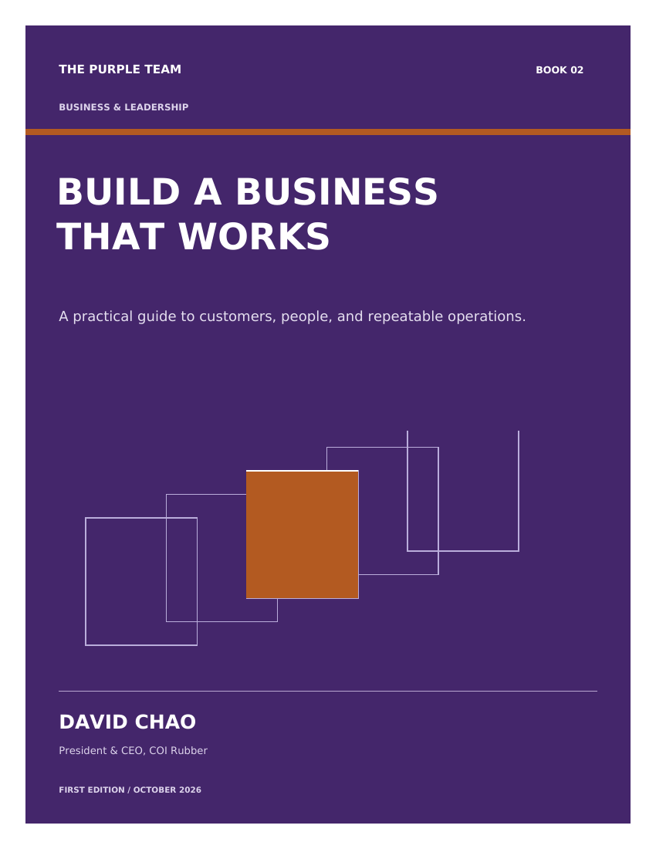
Book 02
Build A Business That Works
Business and leadership
Pick customers worth serving
Know the economics of your work
Build an operating rhythm
Expand only when the evidence supports it
The Purple Team - Powered by COi Rubber
8 / 16
Notes:
Book walk-through 02 (4 min each, 24 min total). Think like an owner: a simple process used consistently beats a complicated one abandoned. Point the room to the free download: coirubber.com/reps/purple-team-library/. Each book ends with worksheets - read one chapter, practice one behavior, record what happened.

Slide 9

Book 03
Build A Life You Believe In
Motivation and purpose
Choose a direction you can respect
Build confidence through practice
Learn from the difficult week
Decide what enough means to you
The Purple Team - Powered by COi Rubber
9 / 16
Notes:
Book walk-through 03 (4 min each, 24 min total). Think like an owner about your life too: a direction you respect, practiced weekly, carries you further than bursts of effort. Point the room to the free download: coirubber.com/reps/purple-team-library/. Each book ends with worksheets - read one chapter, practice one behavior, record what happened.

Slide 10
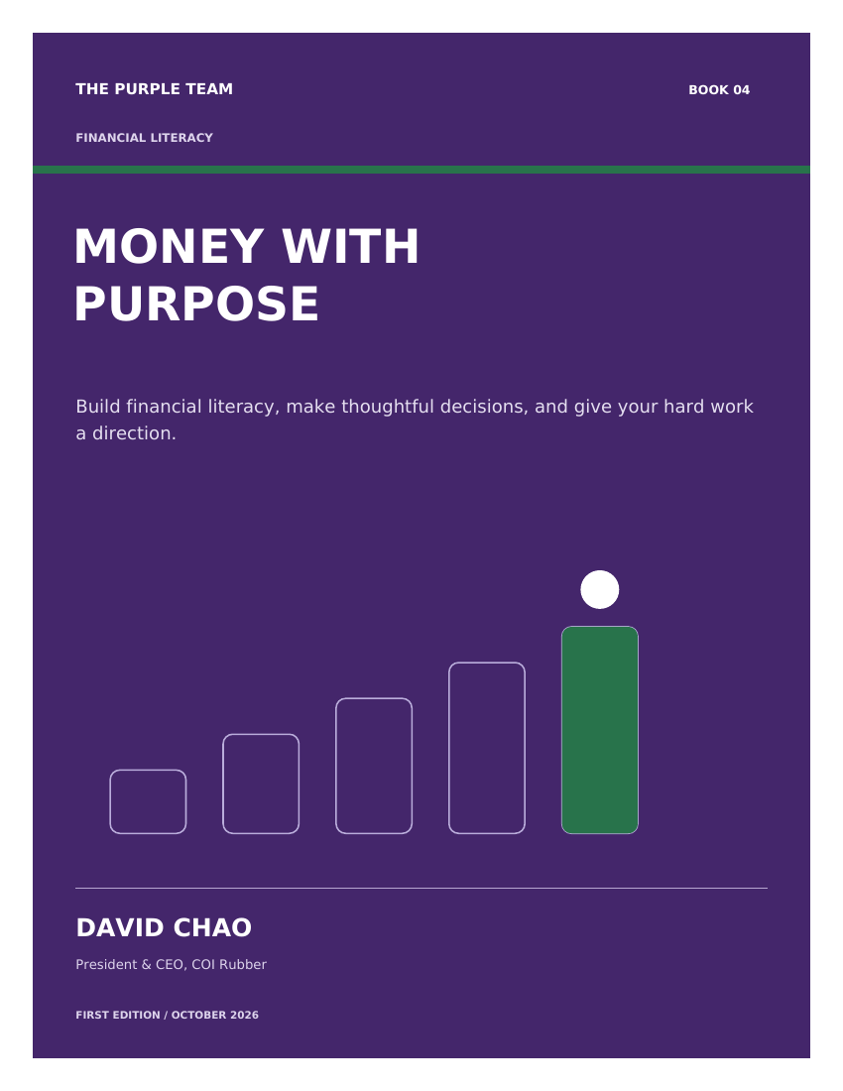
Book 04
Money With Purpose
Financial fundamentals
Give each dollar a purpose
Prepare for uneven income
Manage debt and understand credit
Make decisions you can explain
The Purple Team - Powered by COi Rubber
10 / 16
Notes:
Book walk-through 04 (4 min each, 24 min total). Commission income is uneven by nature - plan for that from day one, with reserves and a written cash-flow plan. Point the room to the free download: coirubber.com/reps/purple-team-library/. Each book ends with worksheets - read one chapter, practice one behavior, record what happened.

Slide 11
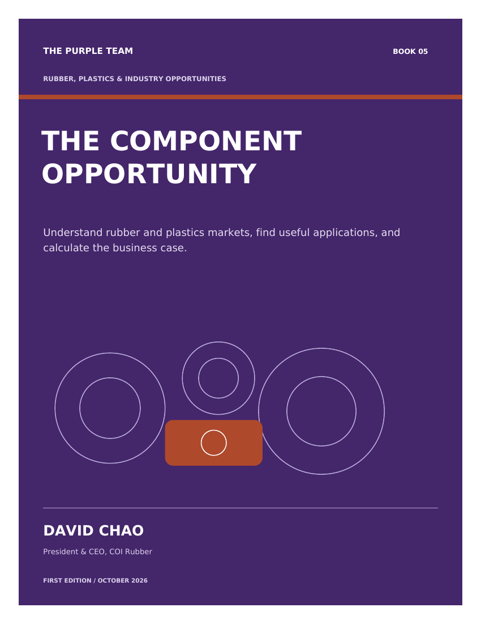
Book 05
The Component Opportunity
The industry
Where rubber and plastic parts show up
How to read a market
What a real opportunity looks like
How a business case is calculated
The Purple Team - Powered by COi Rubber
11 / 16
Notes:
Book walk-through 05 (4 min each, 24 min total). Learn the landscape of twelve industries that buy custom components, and how to spot a qualified opportunity inside one. Point the room to the free download: coirubber.com/reps/purple-team-library/. Each book ends with worksheets - read one chapter, practice one behavior, record what happened.

Slide 12
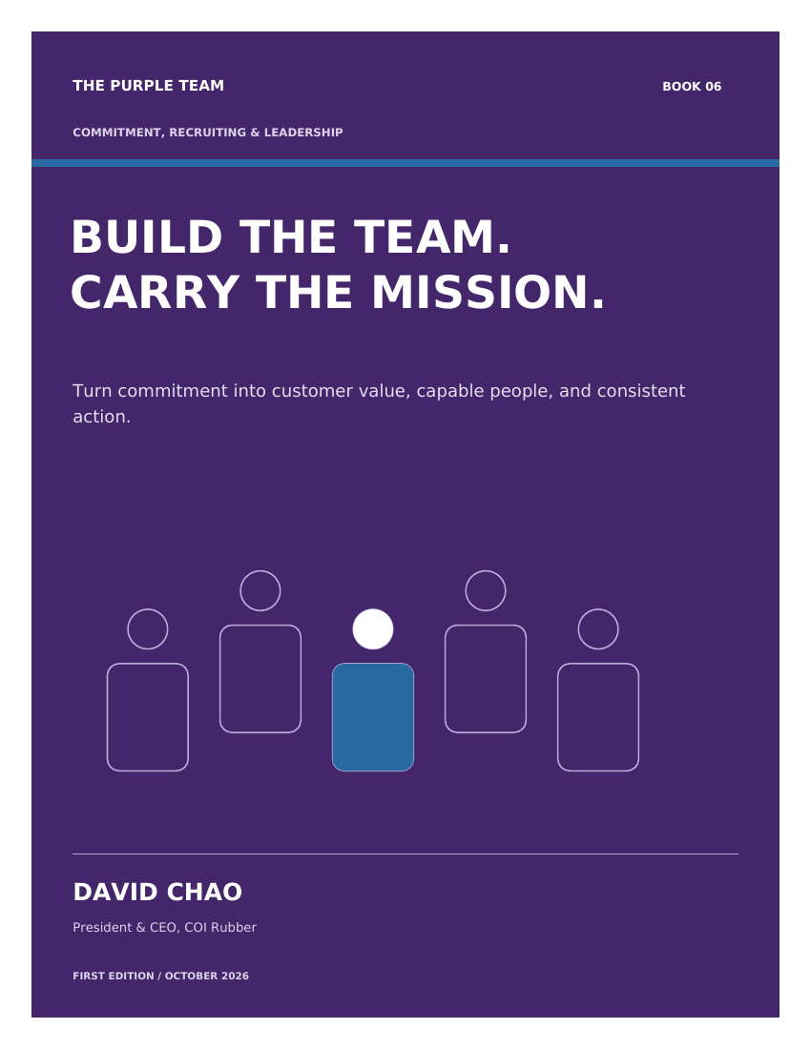
Book 06
Build The Team.
Carry The Mission.
Team leadership
Choose a commitment you can keep
Invite people with clarity and respect
Help a new person become capable
Run a focused 90-day cycle
The Purple Team - Powered by COi Rubber
12 / 16
Notes:
Book walk-through 06 (4 min each, 24 min total). For those who grow into leadership: develop people through real work, coach the work, and keep your own week honest. Point the room to the free download: coirubber.com/reps/purple-team-library/. Each book ends with worksheets - read one chapter, practice one behavior, record what happened.

Slide 13
PART 4 - GETTING STARTED
Your first 30 days
Read
One chapter at a time. The guides are short, free and written from real industrial sales work.
Practice
One behavior per chapter. Open a conversation. Take discovery notes. Prepare one clean RFQ handoff.
Review
Use the worksheets. A manager or mentor reviews them with you - clear records let others help you.
The Purple Team - Powered by COi Rubber
13 / 16
Notes:
Turn learning into motion (3 min). The 30-day frame keeps new reps from stalling in preparation. Read, practice, review - weekly. The worksheets are working tools, not applications or contracts. Transition: so who should actually raise a hand?

Slide 14
PART 4 - FIT
Who the Purple Team is for
Experienced representatives
Already calling on buyers? Add COi to your existing product lines - non-exclusive.
Your buyers need a second source. Be the rep who brings it.
Newcomers
Apply for consideration in the developing pilot program.
Bring a burning desire for hard work and learning - the guides and coaching teach the rest.
The Purple Team - Powered by COi Rubber
14 / 16
Notes:
Qualify the room (3 min). Two doors in. Experienced reps add COi as another line, non-exclusive. Newcomers apply to the pilot and are reviewed - not everyone is accepted. Either way, the first step is the same: read the guides. Transition: here is exactly how to do that.

Slide 15
PART 4 - NEXT STEP
How to apply
1. Read the free Purple Team guides
2. Submit the free application at coirubber.com/reps/
3. Our team reviews every application - applicants are not yet accepted representatives
4. Next steps, training and terms are explained before onboarding
Straight talk
Applying is free.
Participation and earnings are not guaranteed.
The Purple Team - Powered by COi Rubber
15 / 16
Notes:
The ask (3 min). Keep it soft and honest: read, then apply. No fees to apply, no promises of acceptance, no earnings claims. The review protects both sides. Anyone who is still interested after an honest hour is exactly who we want applying. Then open the floor.

Slide 16
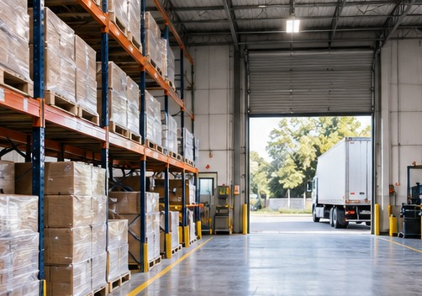
Questions
Read the free guides: coirubber.com/reps/purple-team-library/
Apply or learn more: coirubber.com/reps/
The Purple Team is a proposed pilot program. Participation and earnings are not guaranteed.
Notes:
Q&amp;A (remaining time, ~10 min). Answer honestly, including 'that part is still being built.' Close by pointing to the two links and thanking the room.

